Slide 1

מנחה מקצועית:
טליה מרמור בן רעי
מנחים אקדמים:
ד"ר ארנון שטורם
ד"ר יוסי אורן
סטודנטים:
שי דיין
רועי פילר
מגל וייס

Slide 2

Background
There is a need for modern tools for effective and fast writing skills improvement
There is a need for attracting students in the fast growing technology world
Excellent writing skills significantly help to get opportunities in the real world

Slide 3
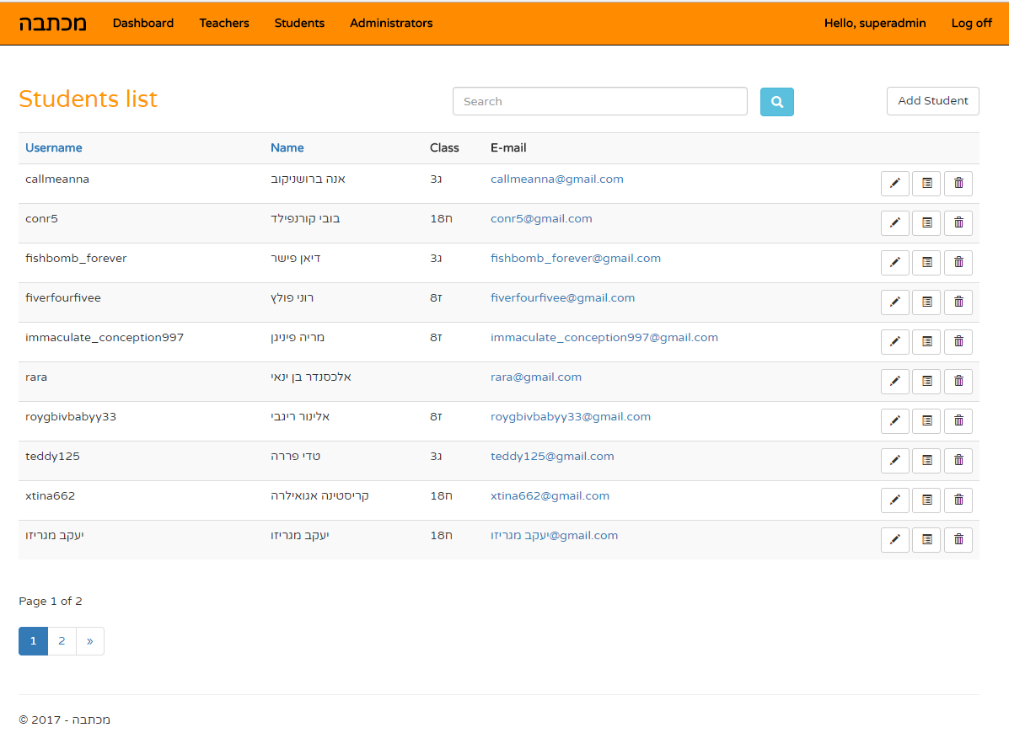
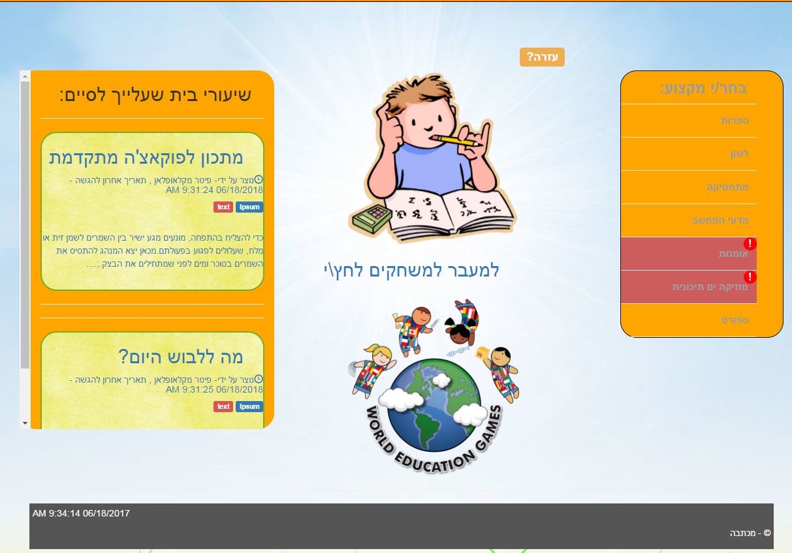
Michtava Solution
Friendly WEB learning system
Three roles – Student, Teacher and Administrator
Uploading and managing contents
Smart Textbox for supporting and improving students’ answers in real-time

Slide 4



Choosing The Technology
 | Easy code maintenance | Availability for different devices and operating systems | Easy deployment And software updates | Friendly and rich development environment
Angular
Node.js
.NET Desktop

Slide 5
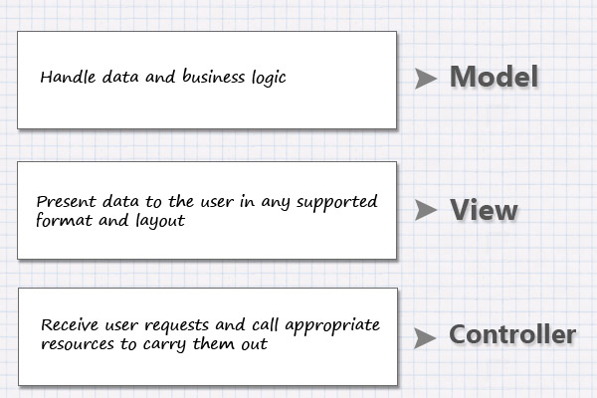
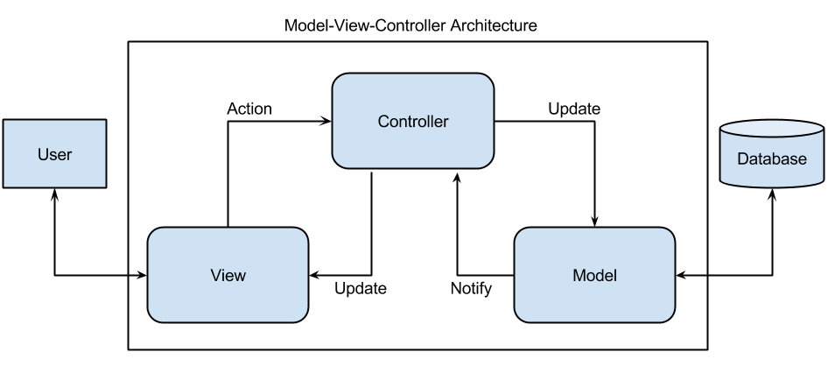
MVC Architecture

Slide 6

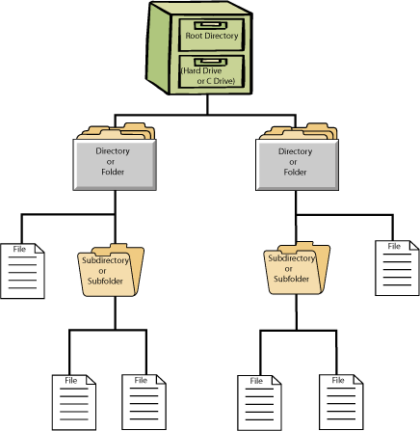
Challenge 1
The Problem: Data loss in case of connection issues and system errors.
The Solution: Temporary Files System.
Managing temporary folders and files
Writing Objects into files and parsing files into Objects
Unique folder per session

Slide 7
Challenge 2
The Problem: Every small change in the business model leads to a complex migration process and slows down the development.
The Solution: Automatic migration process.
1
2
3

Slide 8
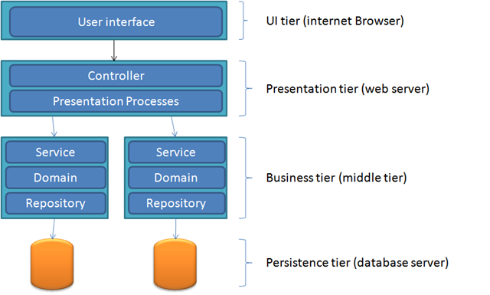
System Architecture
SmartTextBox
Service
Logic
FileHandler
Service
Logic

Slide 9
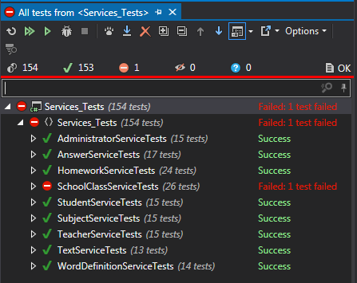

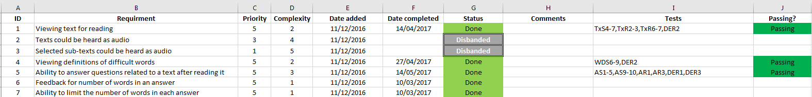
The Development Process
Version control with Bitbucket
Requirement traceability document
Manual and automated tests per requirement
Independent software components and work areas
Task prioritization
Team meetings

Slide 10
Conclusions
1
2
3

Slide 11

Q & A
Thank You!

